Slide 1


STATISTICS II
Project 1
Pavlos Polyzogopoulos (bapt1730)
Dimitris Karlis

Slide 2
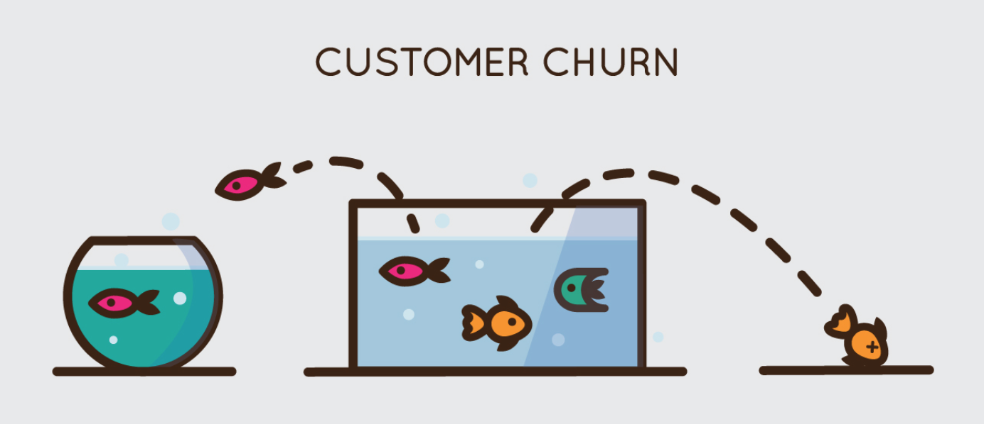
Problem review
The goal is to describe customer behavior in respect to the probability of churn

Slide 3
Churn
Customer churn:
Occurs when customers or subscribers stop doing business with a company or service, also known as customer attrition.
It is also referred as loss of clients or customers.
One industry in which churn rates are particularly useful is the telecommunications industry.
As most customers have multiple options from which to choose within a geographic location.

Slide 4
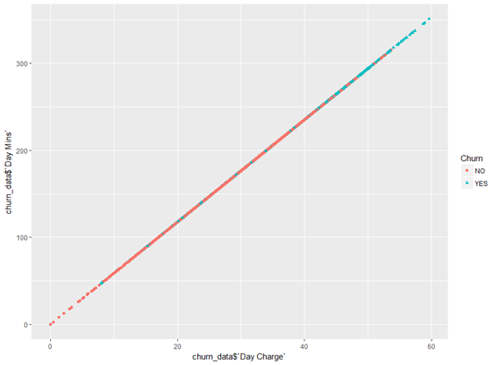
Correlation between charts per minute in day and churn
There is a strong relation between the customers who churn and the charge in days

Slide 5
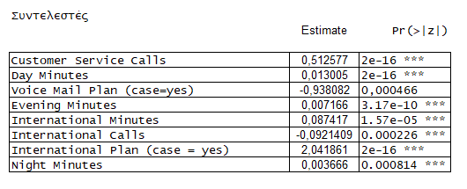
The model Coefficients
Voice mail plan and international calls are positively associated with the chance that a customer will not churn

Slide 6
Watch outs
Matters to take into consideration:
Pricing policy
Number of customer complaints
Reevaluation of customers services

